Slide 1


Statistic
Lecture 10
Dr. Nada Abdullah Rasheed
Assist prof. / Computer Science

Slide 2
Syllabus Content
Subject | Lec. No.
Making Inferences about Regression Equations and Coefficients | 3

Slide 3
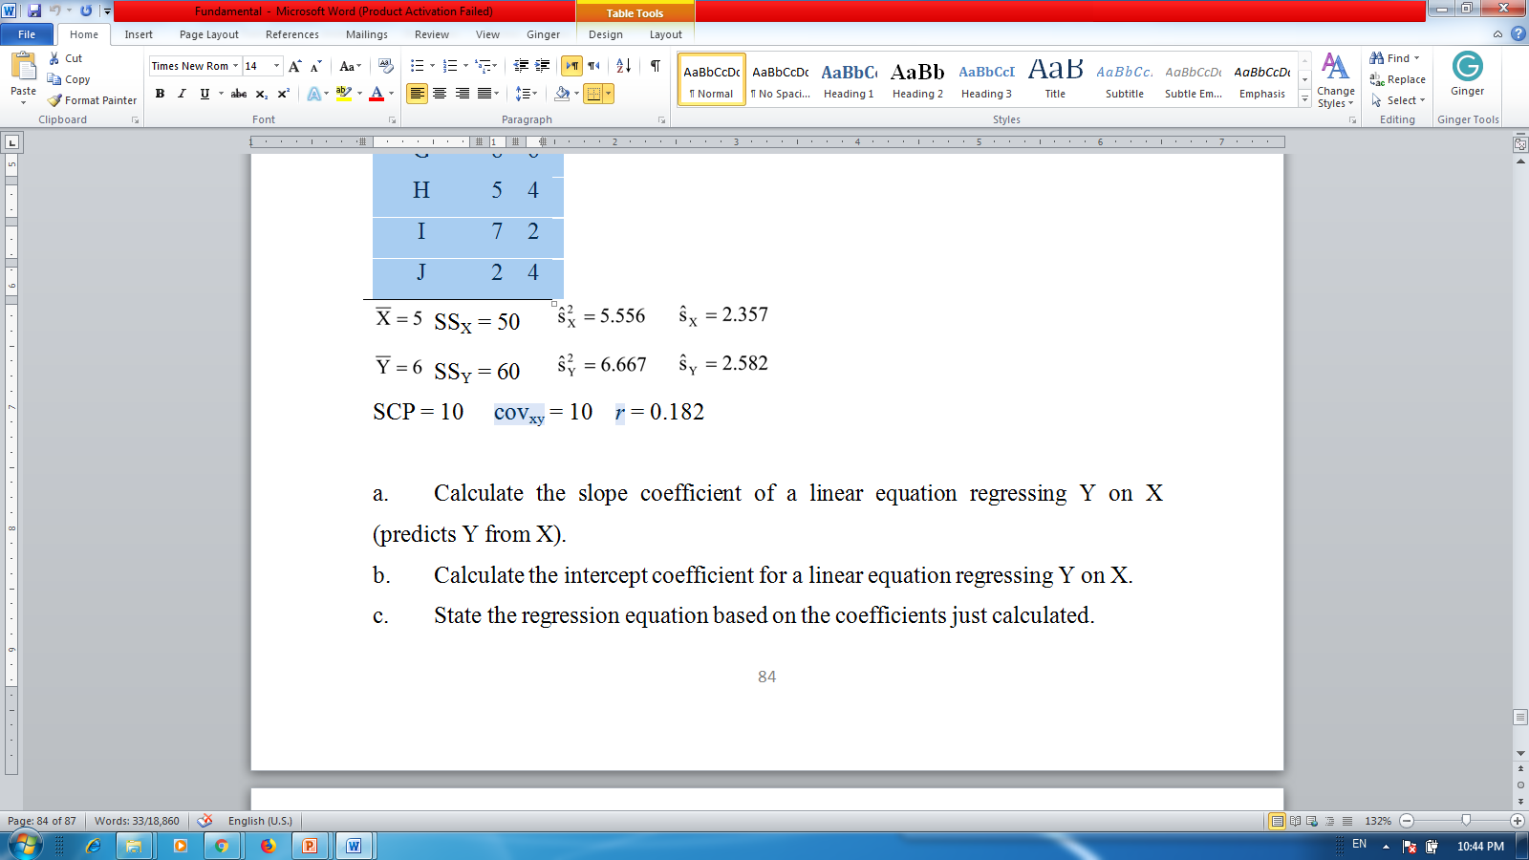

Slide 4
Calculate the slope coefficient of a linear equation regressing Y on X (predicts Y from X).
Calculate the intercept coefficient for a linear equation regressing Y on X.
State the regression equation based on the coefficients just calculated.
Calculate the predicted values of Y (Y’) for each of the following individuals.
Individual A
Individual G
Individual J
Calculate the sum of squares residual and the sum of squares regression (using the computational methods).
Calculate the standard error of the estimate. What does this value tell you about the predicted values of Y?

Slide 5
Use the following to answer the questions below: A professor has noticed that students who lack basic math skills do not perform well in his statistics course. The professor creates a math pretest that has a range of zero to ten. The test is given at the first class meeting to determine whether each student has the math skills necessary for the statistics course (n = 8). To evaluate the validity of his pretest, at the end of the semester the professor regresses student course grade points (Y) on the pretest scores (X). The regression equation and statistics appear in the table below.

Slide 6
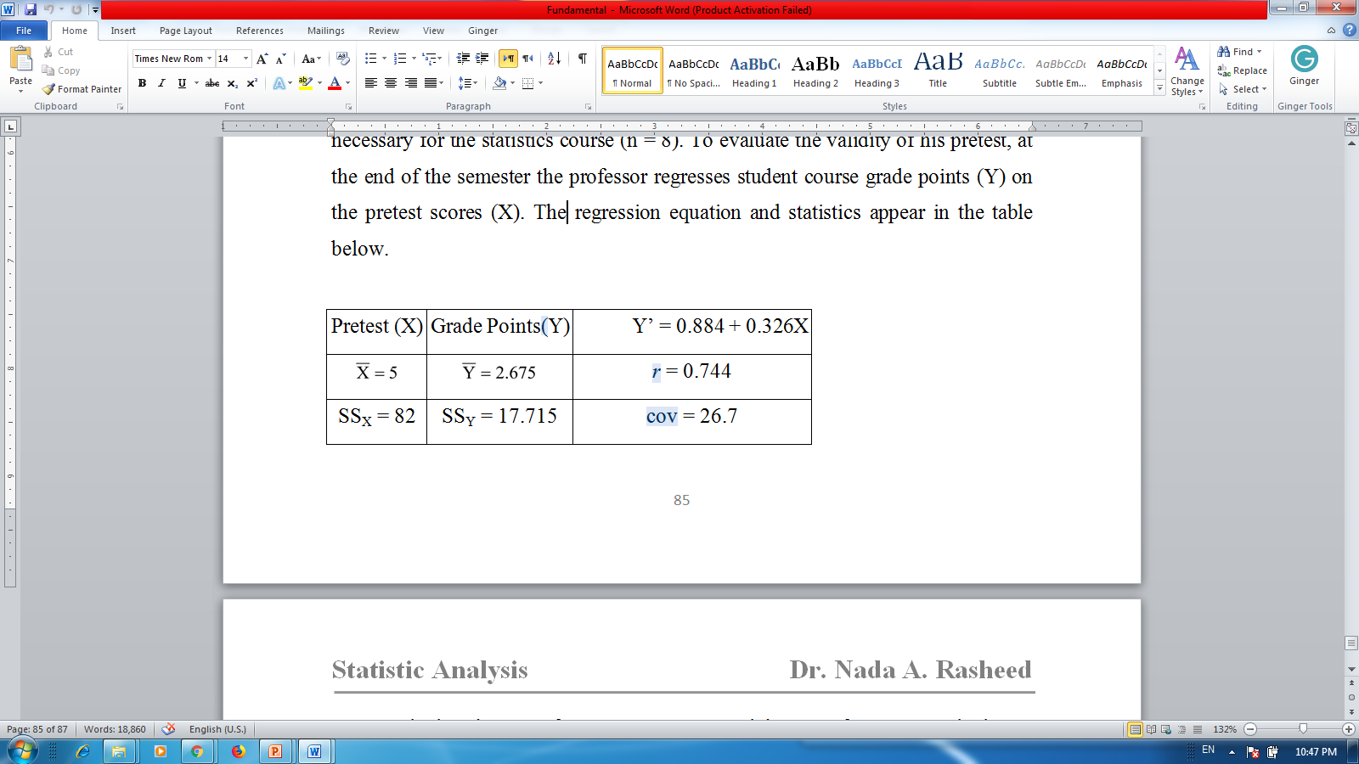

Slide 7
Calculate the sum of squares regression and the sum of squares residual.
Determine the degrees of freedom regression, degrees of freedom residual, and degrees of freedom total.
Calculate the mean square residual and the mean square regression
Calculate the F-Ratio.
Determine the p-value for the F-Ratio.
Using α = .05, is the regression equation statistically significant? Why?
Calculate the standard error of the estimate from the average residual variance (MS_{Residual}).

Slide 8
Calculate the standard error of the slope SE(b₁) and standard error of the intercept SE(b₀).
Calculate the t-Value for the slope (b₁). What is the p-value?
Calculate the t-Value for the intercept (b₀). What is the p-value?

